Slide 1
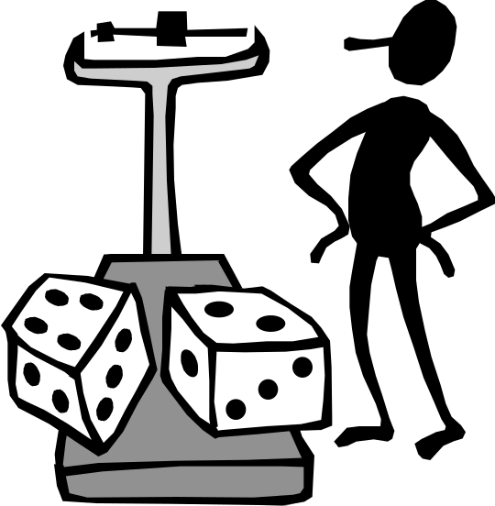
Reading Measurements
Measuring in grams
Guess the amount in the scale.

Slide 2
Counting on in 100s
100
200
300
400
500
600
700
800
900
1000
Counting on in 50s
50
150
250
350
450
550
0
100
200
300
400
500
600

Slide 3
Where will the pointer go?
300g
250g
350g
200g
400g
150g
450g
100g
50g
100g
500g
100g
50g
50g
100g
Reading a scale in grams

Slide 4
100g
300g
Where will the pointer go?
250g
350g
200g
400g
150g
450g
50g
100g
500g
100g
50g
50g
100g
Reading a scale in grams

Slide 5
100g
100g
300g
Where will the pointer go?
250g
350g
200g
400g
150g
450g
50g
100g
500g
50g
50g
100g
Reading a scale in grams

Slide 6
100g
100g
100g
300g
Where will the pointer go?
250g
350g
200g
400g
150g
450g
50g
100g
500g
50g
50g
Reading a scale in grams

Slide 7
50g
100g
300g
Where will the pointer go?
250g
350g
200g
400g
150g
450g
100g
500g
100g
50g
50g
100g
Reading a scale in grams

Slide 8
50g
50g
100g
300g
Where will the pointer go?
250g
350g
200g
400g
150g
450g
100g
500g
100g
50g
100g
Reading a scale in grams

Slide 9
50g
50g
50g
100g
300g
Where will the pointer go?
250g
350g
200g
400g
150g
450g
100g
500g
100g
100g
Reading a scale in grams

Slide 10
50g
50g
50g
100g
100g
100g
Reading a scale in grams

Slide 11
3 kg
2 kg
1
2
1
2
3 kg
4 kg
2 kg
4 kg
1
2
1 kg
1
2
1 kg
5kg
Reading a scale in kilograms

